Slide 1
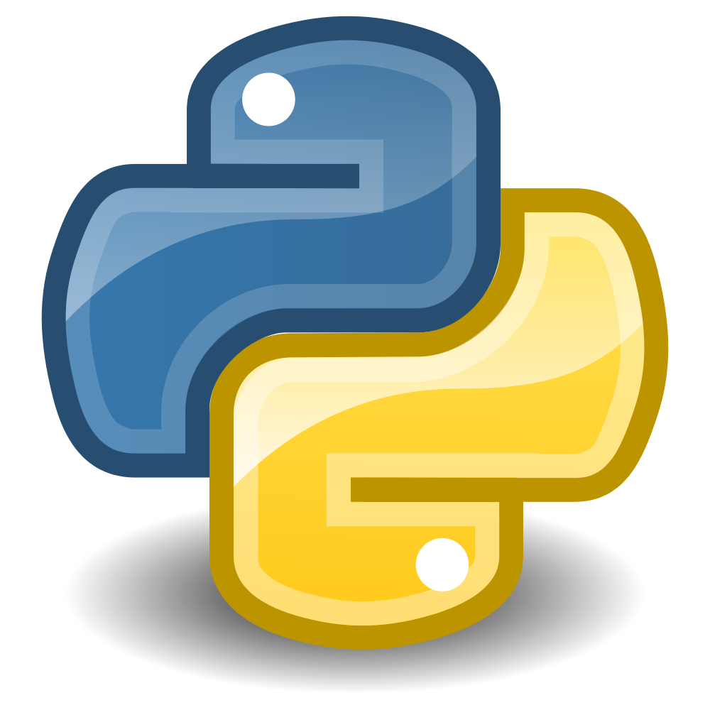
Programming with Python

Slide 2
Downloading Python
Go to https://www.python.org/downloads
Scroll down to the Release Versions and select Python 3.5.3
Scroll down to Files and select your operating system’s version of the installer.
After the download is complete, open the installer and follow the instructions.

Slide 3
Downloading PyCharm, a Python IDE
Go to https://www.jetbrains.com/pycharm/download
Select Download under the Community edition
Open the installer and follow the instructions
After completed, in the small window select Configure -> Settings -> Project Interpreter and in the drop down box labeled Project Interpreter select 3.5.3 (location of your installation here) this should be the only option if you have never had python on your computer before
Click Apply

Slide 4
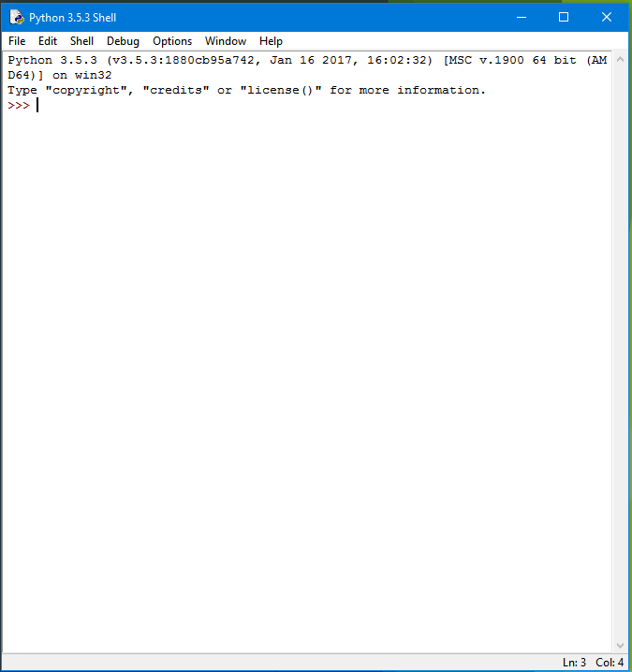
Python IDLE
Go to Spotlight (Mac) or the Start button (Windows) and type “IDLE” and open what pops up.
This is python’s Integrated DeveLopment Environment. It comes with your Python 3.5.3 download.
Here, you can type in a line of code and press Enter and the interpreter will run that line of code immediately. This is good for trying out new things, and exploring python in general.

Slide 5
Try it out!
Lets try out the IDLE and write your first line of code. With the IDLE open, type in print(“Hello World!”) exactly as I have and press enter.
1
Hello World! Should have popped up on the next line. Congratulations! You now have miniscule experience in Python.
2

Slide 6
Moving on…
IDLE is fun and handy, but it won’t be useful for developing larger projects such as our Sudoku Solver. Lets open up PyCharm. ( You probably already have it open)
PyCharm is an Integrated Development Environment (IDE). It helps you by highlighting words that are the same, making code completion predictions, underling errors…. Sort of like the Microsoft Word for programming. There are TONS of other IDE’s out there that support various languages.
Lets start a new project in PyCharm

Slide 7
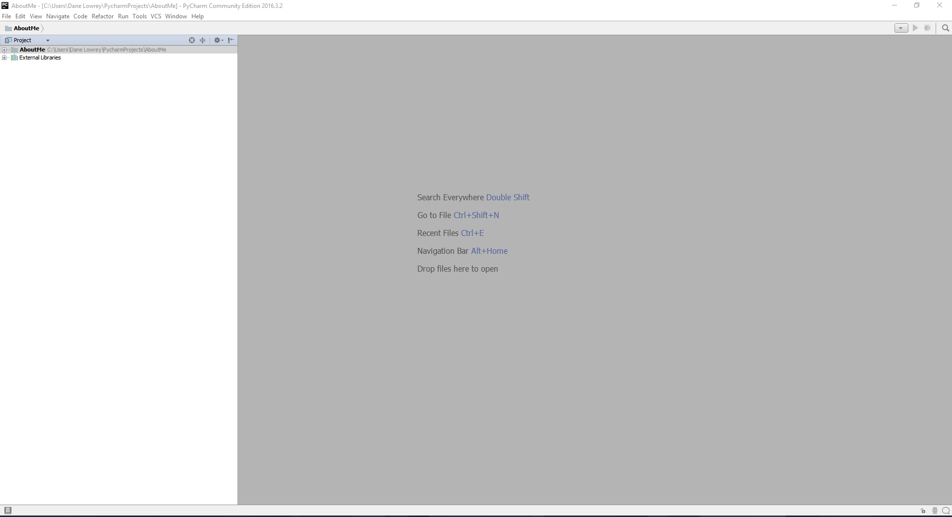
MyFirstProject - My first real Python Project
Okay lets go a little quicker now. With PyCharm open, click Create New Project
Title your project MyFirstProject (the title of the project is at the very end of the file path where it will be saved. Mine looks like C:\Users\Dane Lowrey\PycharmProjects\MyFirstProject)
Click Create
You should have something similar to this now

Slide 8
Data types
Data types are a way to tell the computer how to interpret and use the data.
Some data types are:
Integers : natural numbers i.e. -1, 0, 1, 2, 3, 4…
Strings : words, sentences, i.e. “hello world!” (strings are denoted by surrounding quotation marks)
Floats : decimal numbers, i.e. -1.02, -0.25, 0.25, 1.5…
Data types are fundamental to computer programming. Open up IDLE and type “1” + 2 and hit enter.
You cant mathematically add a string data type and an integer. It just won’t work. Some data types cant be used with each other, keep this in mind!

Slide 9
Circumference.py
Lets make a real program using Pycharm with the language Python
Right click on your MyFirstProject folder and click new -> python file
Name the file circumference
You have now added a file that can contain executable Python code.
Lets start coding our project
This project will take a circle’s radius as input, and output that circle’s area and circumference.
The algorithm for this program will be:
Prompt for a radius
Apply the circumference formula
Apply the area formula
Print out the results

Slide 10
Circumference.py
First we must prompt the user for their input. We need to get the radius of the circle they want to use.
We can do this using the built in function called input()
You can find a list of Python 3.5 Built in functions in the Python DevDocs at http://devdocs.io/python~3.5/library/functions
The input() function takes in a prompt as its parameter. The prompt is some message we want to display to the user, in this case “Enter the radius of your circle”.
The input function will then return whatever the user typed as a String data type.

Slide 11

Circumference.py
Lets prompt the user for input and store the result in a variable called radius_str
We now have the radius of the user’s circle stored in the variable radius_str as a String data type.
To be able to perform mathematical operations on it, we must have a numerical representation of the radius.
Lets cast the contents of radius_str to an integer datatype and store the result in a new variable radius_int
The words in gray above the code are called comments and are useful for telling what you are doing! Comments start with the symbol #. These lines are ignored when the program is run.

Slide 12
Circumference.py
Now we have our data and are ready to move to step 2 and 3 of our algorithm, calculating the area and circumference of the circle with radius radius_int
Formula for circumference: 2πr
Formula for area: πr²
To use π in our equation, we could just use 3.14, but instead we will use a better representation of π using one of python’s many modules, the math module.
Modules are python files containing programs to solve particular problems. In this case, the math module provides programs to use for solving math problems. The math module has the value of π, which we can access by using math.pi

Slide 13
Circumference.py
Import the math module into your python file, typically you want any imports to be the very first code you have.
Now we can apply the circumference and the area formulas using math.pi to represent the number π
The math module also has values for e, infinity, negative infinity, as well as a ton of other helful functions like sinh, cosh, etc. All of those can be found in the Python 3.5 DevDocs here http://devdocs.io/python~3.5/library/math

Slide 14

Circumference.py
In a line below where we created our radius_int variable, create a new variable circumference to store the result of our calculations for circumference
on the right hand side of the statement, use the equation 2πr to solve for the circumference of a circle with radius_int
In python, multiplication is denoted by the asterisk mark *

Slide 15
Circumference.py
Now we need to apply the area formula πr²
To multiply a number x by a power of n, python uses double asterisk ** i.e. x^{n} = x ** n
Can you write the next line of code to calculate the area of the circle with radius radius_int and store it in a variable?
Make sure you comment your code!!!
If you get stuck, look back at the code you already wrote, or ask us for help

Slide 16


Slide 17
Circumference.py
We have now completed steps 1 – 3 of our algorithm. Step 4 is to print out the results
We can do this using the build in function print()
This function is similar to the input function, but instead it puts its parameters on the screen for the user to see.
The print() function can have many parameters, for our case we will just give it what we want it to print, separated by commas.
Here we give the print() function multiple parameters separated by commas.
We give it:
The string “The circumference is:”
The variable holding the value of our circumference
The string “and the area is”
The variable holding our area

Slide 18
Circumference.py
DONE! Now you can right click on your circumference.py file, and click “Run circumference.py”
Your input prompt should show up in the window below your code, type your radius and press enter!
You results should print out in the way you formatted them in the print() function!

Slide 19
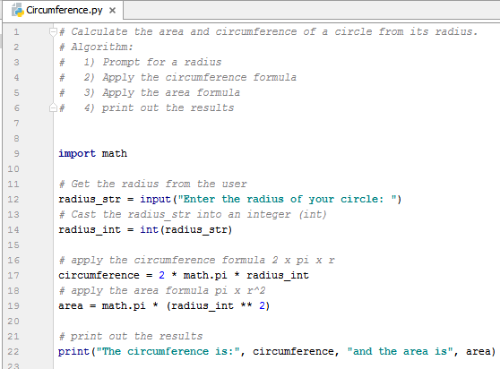

Slide 20
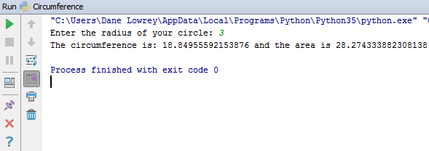

Slide 21
Fahrenheit to Celsius
Can you write a program that will:
Take in a temperature in Fahrenheit as input
Convert the temperature to Celsius using C = (F – 32) / 9 where F is the temperature in Fahrenheit
Print out the results to the user.

Slide 22
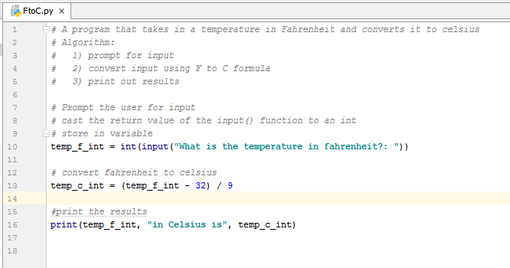

Slide 23
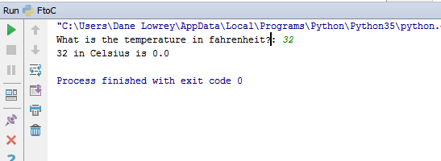

Slide 24

Notice here I immediately cast the string result of the input() function into an integer data type. This is just a short cut. Technically you could do the entire program in one line, like this:
But that is bad and hard to read, and if something were to go wrong it would be hard to find out what was causing the problem. This was just to show you that you can nest functions inside one another, as long as the inner function’s return data type matches the outer functions parameter data type.

Slide 25
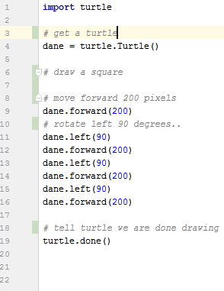
A little fun with turtle Graphics to finish
Programming isn’t just for boring math stuff
You can use the Turtle module to draw lines and make art!
Create a new python file called Turtle in your MyFirstProject directory
At the top, import turtle
You command the “turtle” to turn left, right, up, down, and go forward to draw!
Lets draw a square with a turtle named after you.
If you run this, the turtle will draw a square on screen following your commands!
The functions left() and right() have parameters that are angles, and forward() has a distance for the turtle to draw, both can be data type int or float.

Slide 26
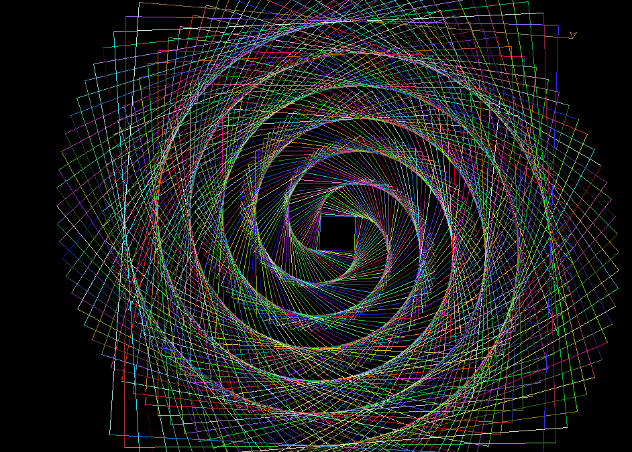
Turtle Graphics Extreme
Turtle graphics can be used to make works of art using loops and variables! We will learn about loops next time.

